Slide 1
Error Detection and Correction

Slide 2
Error Detection and Correction
There are many reasons such as noise, cross-talk etc., which may help data to get corrupted during transmission.
Data-link layer uses some error control mechanism to ensure that frames (data bit streams) are transmitted with certain level of accuracy.

Slide 3
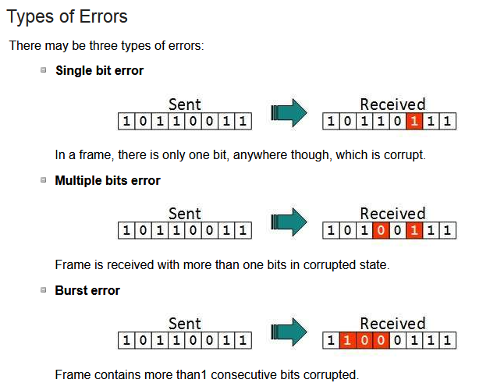
Error Detection and Correction

Slide 4
Error Detection and Correction
Redundancy
Central concept to detect or correct errors
Extra bit/bits with data
Added by sender
Removed by receiver
Detection
Looking only if any error has occurred
Correction
More difficult than detection
Exact number of corrupted bits are required along their location

Slide 5
Error Detection and Correction
Forward Error Correction
Receiver tries to guess the msg from redundant bits
Possible when errors is small
Retransmission
Receiver detects the error and asks the sender to resend
Resending is repeated until the arrival of error-free msg

Slide 6

Error Detection and Correction
Parity Check for Detection
One extra bit is sent along with the original bits to make number of 1s either even in case of even parity, or odd in case of odd parity.
The sender while creating a frame counts the number of 1s in it. For example, if even parity is used and number of 1s is even then one bit with value 0 is added. This way number of 1s remains even. If the number of 1s is odd, to make it even a bit with value 1 is added.

Slide 7
Error Detection and Correction
Parity Check for Detection
The receiver simply counts the number of 1s in a frame. If the count of 1s is even and even parity is used, the frame is considered to be not-corrupted and is accepted.
If a single bit flips in transit, the receiver can detect it by counting the number of 1s. But when more than one bits are erroneous, then it is very hard for the receiver to detect the error.

Slide 8
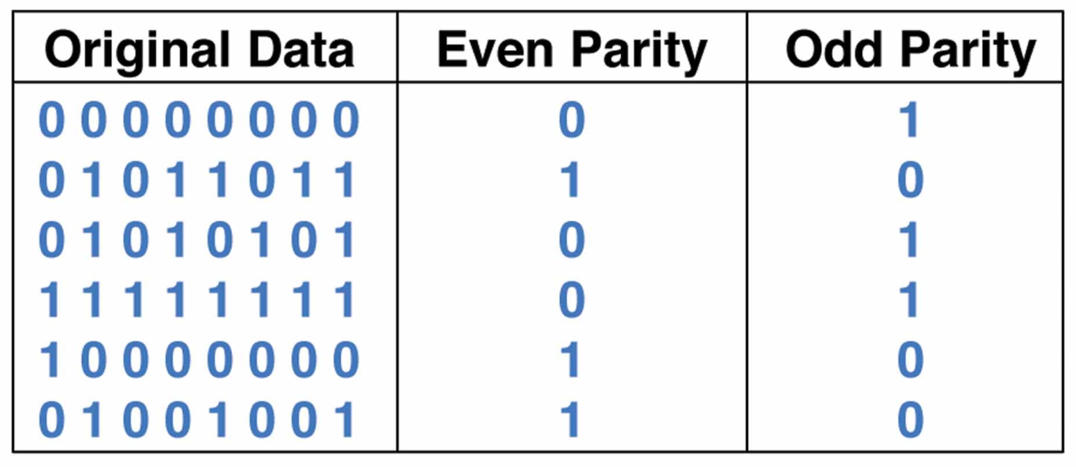
Error Detection and Correction
Parity Check for Detection

Slide 9
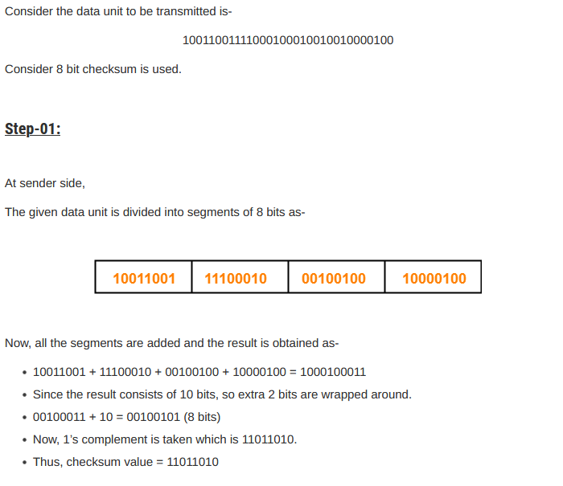
Error Detection and Correction
Checksum for Detection

Slide 10
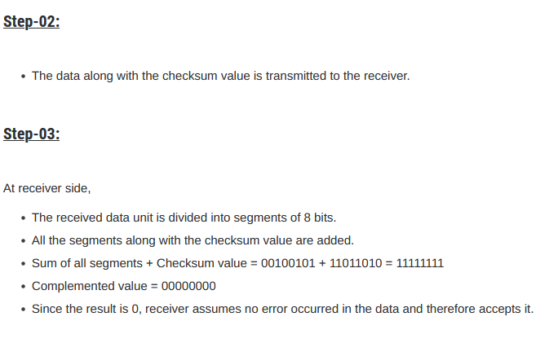
Error Detection and Correction
Checksum for Detection

Slide 11
Error Detection and Correction
Cyclic Redundancy Check (CRC) for Detection
This technique involves binary division of the data bits being sent.
The divisor is generated using polynomials.
The sender performs a division operation on the bits being sent and calculates the remainder.
Before sending the actual bits, the sender adds the remainder at the end of the actual bits.
Actual data bits plus the remainder is called a codeword.

Slide 12
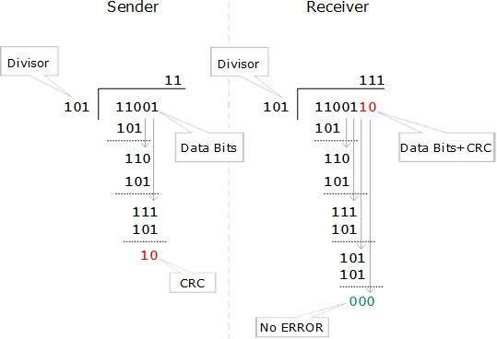
Error Detection and Correction
Cyclic Redundancy Check (CRC) for Detection

Slide 13
Error Detection and Correction
Cyclic Redundancy Check (CRC) for Detection
The polynomial is written in binary as the coefficients; a 3rd-degree polynomial has 4 coefficients (1x³ + 0x² + 1x + 1). In this case, the coefficients are 1, 0, 1 and 1. So, the divisor will be 1011

